Slide 1
Applied Data Science Capstone

Slide 2
Executive Summary
This project investigates SpaceX's Falcon 9 launch data to determine which launch sites and configurations yield successful landings. By applying data wrangling, EDA, visualization techniques, and machine learning models, we aim to identify patterns and improve the prediction of mission outcomes. Interactive dashboards and maps enhance accessibility and interpretation of our results.

Slide 3
Introduction
SpaceX aims to reduce space transportation costs and enable the colonization of Mars. This project focuses on Falcon 9 launches and examines features like launch site, orbit, payload mass, and landing outcomes. The objective is to derive insights from historical data and build models to predict mission success.

Slide 4
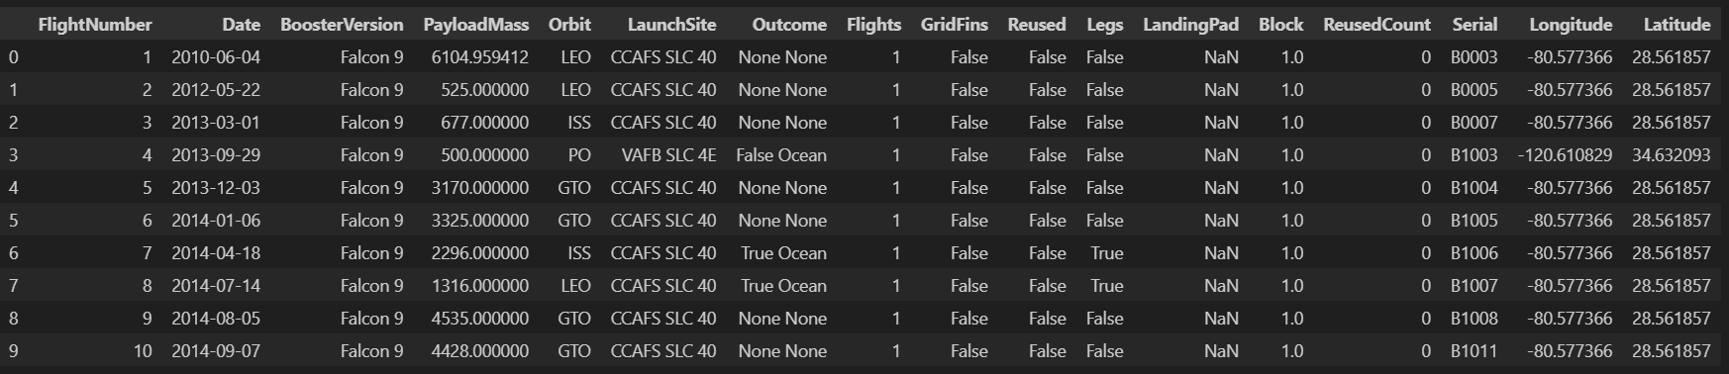
Data Collection & Wrangling
Data Source: SpaceX Falcon 9 dataset (CSV) provided by IBM on Coursera.
Tools Used: Python, Pandas, NumPy.
Key Steps:
Read datasets using pandas.read_csv()

Slide 5
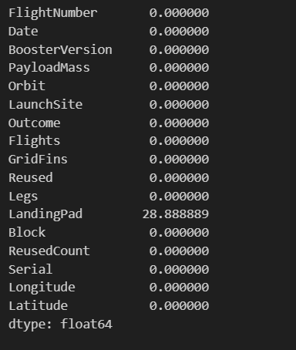
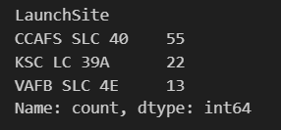
Data Collection & Wrangling
Handled missing values, dropped irrelevant columns (id, Unnamed: 0)
Created new feature Landing_Class based on mission outcome.

Slide 6
EDA Methodology
Univariate analysis to understand distributions
Value counts for LaunchSite, Orbit, and Outcome
Boxplots to detect price outliers
Scatter plots with seaborn.regplot for correlation checks
Groupby analysis for orbit and mission outcome trends

Slide 7
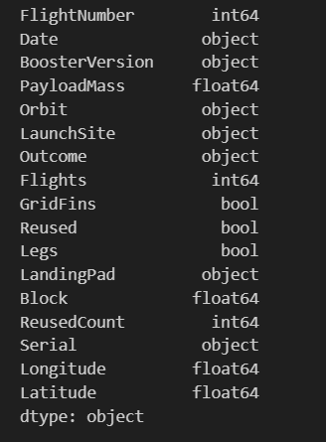
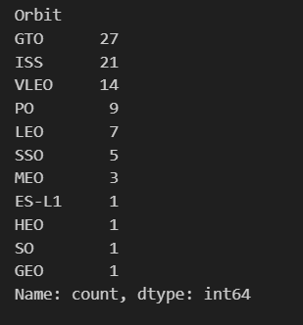
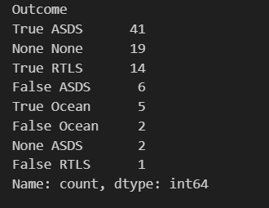
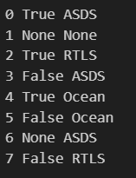
EDA Methodology
Univariate analysis to understand distributions
Value counts for LaunchSite, Orbit, and Outcome

Slide 8
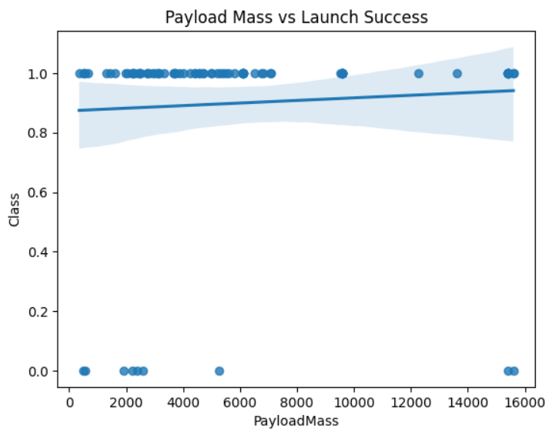
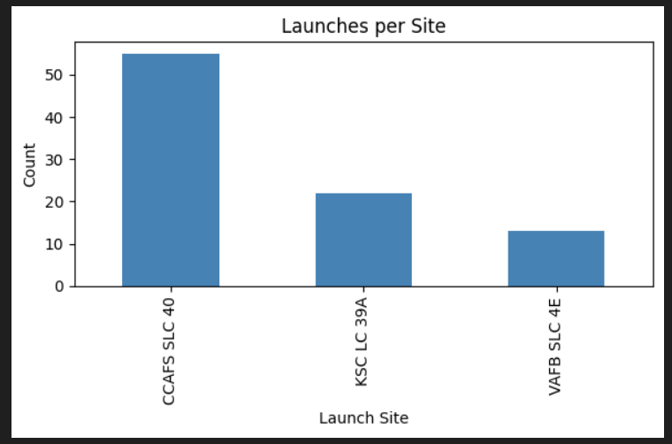
EDA Methodology
Boxplots to detect price outliers
Scatter plots with seaborn.regplot for correlation checks

Slide 9
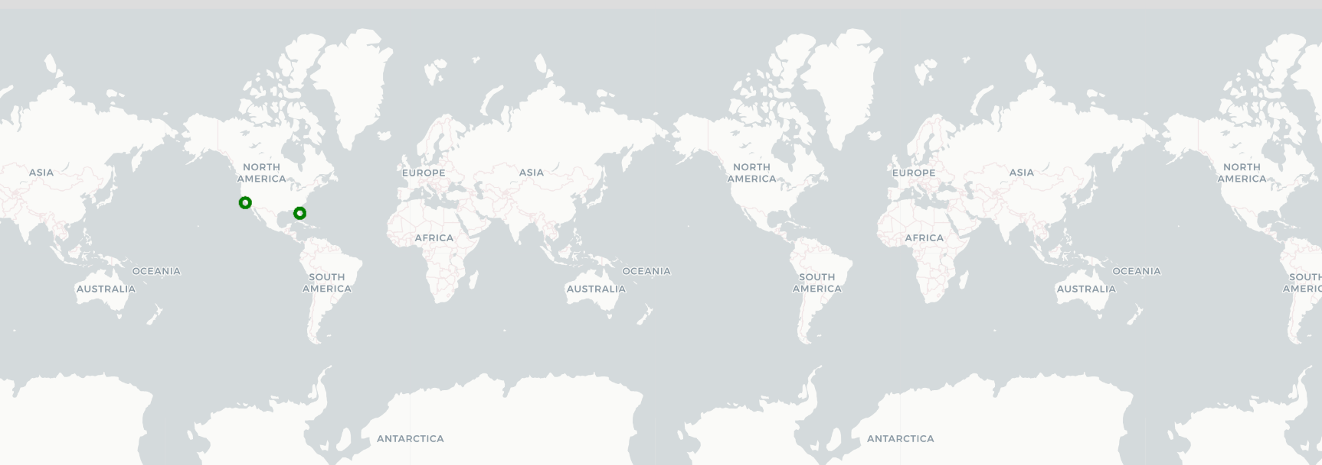
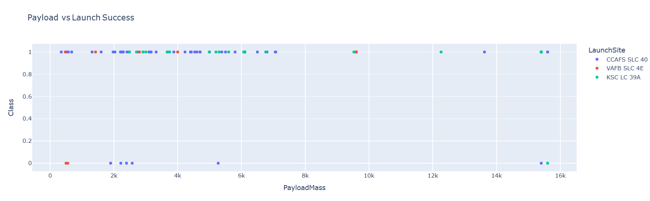
Interactive Visual Analytics Methodology
Used Folium to generate interactive maps
Used Plotly for interactive charts
Dashboards created using Plotly Dash for real-time filtering and analysis

Slide 10

Predictive Analysis Methodology
Regression and classification models used
Linear Regression: predict PayloadMass from FlightNumber
Ridge Regression with polynomial transformation
Logistic Regression to classify mission outcome (Landing Success)

Slide 11
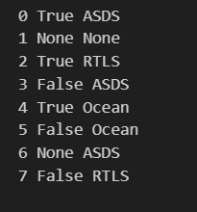
EDA Visualization Results (1/2)
LaunchSite Frequency:
CCAFS LC-40: Most frequent
KSC LC-39A & VAFB SLC-4E follow
Orbit Types:
LEO most common, followed by GTO and ISS
Mission Outcomes:
High success with True ASDS, True RTLS
None and False represent failures

Slide 12
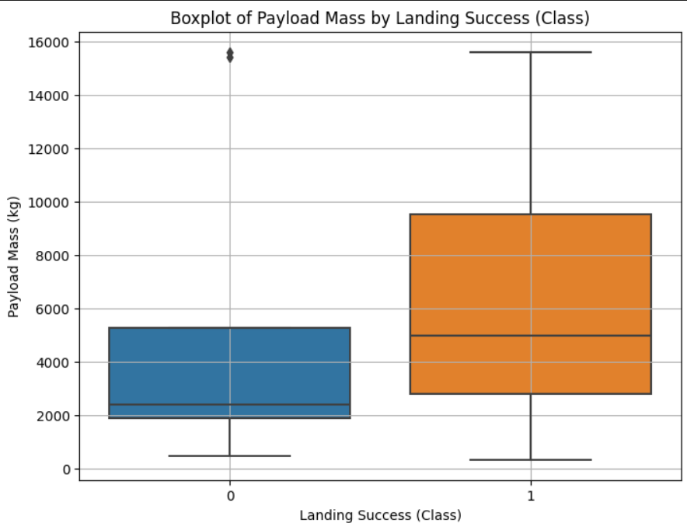
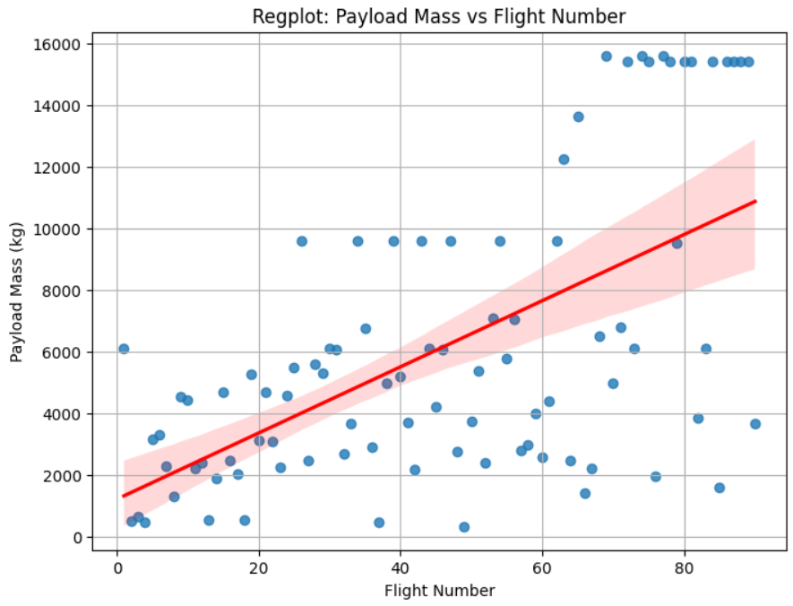
EDA Visualization Results (2/2)
Boxplot: More outliers in PayloadMass for failed landings (Class = 0) than for successful ones (Class = 1)
Regplot: PayloadMass is positively correlated with FlightNumber
Features like BoosterVersion and FlightNumber show consistent trends, but PayloadMass plays a significant role in launch outcomes

Slide 13

SQL Analysis Results
Total launches to GEO: 27
Total successful landings on drone ships (True ASDS): 41
Launch counts by site, orbit distribution, and outcome analysis using pandasql and SQL queries on sqlite3

Slide 14
Folium Interactive Map Results
Visualized all SpaceX launch sites on an interactive world map
Clickable markers display location and site info
Shows geographical trends in launch site usage

Slide 15
Plotly Dash Dashboard Results
Interactive dropdown to select launch site
Pie chart for successful vs failed missions
Scatter plot of payload mass vs mission outcome
Easy-to-use UI built with callbacks in Dash

Slide 16
Predictive Analysis Results
Regression and classification models used
Linear Regression: predict PayloadMass from FlightNumber
Ridge Regression with polynomial transformation
Logistic Regression to classify mission outcome (Landing Success)

Slide 17
Conclusion
Launch site and orbit type significantly affect mission success.
Strong predictors of successful landing: payload mass, orbit, and site.
Interactive visualizations and models enhance interpretability.
Predictive models offer valuable insights for future SpaceX missions.

Slide 18
Creativity & Insights
Added real-time interactivity using Dash and Folium
Inferred correlation between site configuration and success rate
Suggested deployment of dashboard for operations team at SpaceX

